Slide 1

Course Name - Object Oriented Programming using Java
Lecture 27 – Exception handling - Basics, different types of exception classes. Difference between Checked & Unchecked Exception
Presented By
Dr. Sudipta Sahana
Asso. Prof.
Dept. of CSE
UEM – Kolkata

Slide 2
Topic of Interest
Concept of Exception Handling
Types of Exception Handling
Types of Exception Classes
Examples of JAVA Exception
Difference Between Checked & Unchecked Exception

Slide 3
Concept of Exception Handling
Exception is an abnormal condition arising inside a program which disrupts the normal flow of that program at the time of execution.
Reason for Exception:
User has entered invalid and improper data.
A file that needs to be opened has already been deleted.
Network connection has been lost during communications between nodes.
JVM has run out of memory.

Slide 4
Concept of Exception Handling Continued…
Exception Handling: Exception Handling is a process to maintain normal flow of the program by avoiding any kind of abnormal condition arises during program execution.
Note: In Exception Handling we should try to catch the exception object thrown by the error condition and give a proper guidance to user to take necessary actions.

Slide 5
Concept of Exception Handling Continued…
Let's take a scenario:
Program A {
statement 1;
statement 2;
statement 3;
statement 4;
statement 5;
statement 6;
statement 7; //Abnormal condition/exception arises during execution
statement 8;
statement 9;
statement 10;
statement 11;
statement 12;
}
Suppose there are twelve statements in my program and there occurs an exception at statement seven, rest of the code will not be executed i.e. statement seven to twelve will not run. By using exception handling, rest of the statement will be executed.

Slide 6
Types of Exception Handling
The following are the two types of Exception Handling:
Checked Exception
Unchecked Exception
Checked Exception: If a file is to be opened, but the file cannot be found, an exception occurs. These exceptions are checked at compile-time and cannot simply be ignored at the time of compilation. Classes which extend the Throwable class (excluding RuntimeException and Error) are known as checked exceptions. A checked exception is typically a user error or a problem that cannot be observed by the programmer.
Example of Checked Exception: IOException, SQLException etc.

Slide 7
Types of Exception Handling Continued…
Unchecked Exception: This exception is checked during execution of the program and also ignored at the time of compilation. Unchecked Classes which extend the RuntimeException class are known as Unchecked Exceptions.
Example of Unchecked Exception:
a)ArithmeticException,
b)NullPointerException etc.
Error:
Irrecoverable Circumstances arises at the time of program execution is called error. Error is actually not an exception. In case of error problem arises beyond the control of the user or the programmer. For example, if there is a semicolon missing at the end of a statement or braces are not properly closed in a program an error will arise.

Slide 8
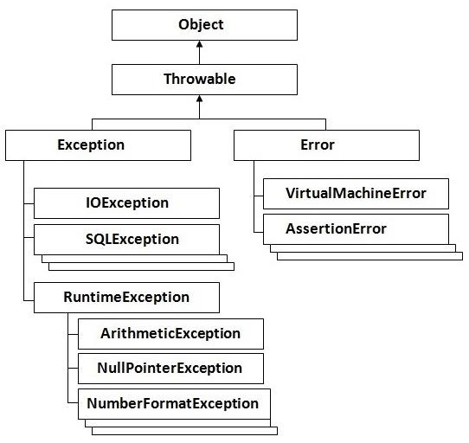
Types of Exception Classes

Slide 9
Types of Exception Classes Continued…
JAVA – Built in Exceptions:
List of Java Unchecked Exception
Exception | Description
ArithmeticException | Arithmetic error, such as divide-by-zero.
ArrayIndexOutOfBoundsException | Array index is out-of-bounds.
ArrayStoreException | Assignment to an array element of an incompatible type.
ClassCastException | Invalid cast.
IndexOutOfBoundsException | Some type of index is out-of-bounds.
NegativeArraySizeException | Array created with a negative size.
NullPointerException | Invalid use of a null reference.
NumberFormatException | Invalid conversion of a string to a numeric format.
SecurityException | Attempt to violate security.
StringIndexOutOfBounds | Attempt to index outside the bounds of a string.
UnsupportedOperationException | An unsupported operation was encountered.

Slide 10
Types of Exception Classes Continued…
List of Java Checked Exceptions Defined in java.lang
Exception | Description
ClassNotFoundException | Class not found.
CloneNotSupportedException | Attempt to clone an object that does not implement the Cloneable interface.
IllegalAccessException | Access to a class is denied.
InstantiationException | Attempt to create an object of an abstract class or interface.
InterruptedException | One thread has been interrupted by another thread.
NoSuchFieldException | A requested field does not exist.
NoSuchMethodException | A requested method does not exist.

Slide 11
Examples of JAVA Exception
ArithmeticException :
If we divide any number by zero, there occurs an ArithmeticException.
int a=10/0;//ArithmeticException
NullPointerException :
If we have null value in any variable, performing any operation by the variable occurs an
NullPointerException.
String s=null;
System.out.println(s.length());//NullPointerException
ArrayIndexOutOfBoundsException :
If you are inserting any value in the wrong index, it would result
ArrayIndexOutOfBoundsException as shown below:
int a[]=new int[5];
a[15]=750; //ArrayIndexOutOfBoundsException

Slide 12
Difference Between Checked & Unchecked Exception
Checked Exception:
The classes which directly inherit Throwable class except RuntimeException and Error are known as checked exceptions e.g. IOException, SQLException etc. Checked exceptions are checked at compile-time.
Unchecked Exception:
The classes which inherit RuntimeException are known as unchecked exceptions e.g. ArithmeticException, NullPointerException, ArrayIndexOutOfBoundsException etc. Unchecked exceptions are not checked at compile-time, but they are checked at runtime.
Error
Error is irrecoverable e.g. OutOfMemoryError, VirtualMachineError, AssertionError etc.

Slide 13
Thank You

